Slide 1

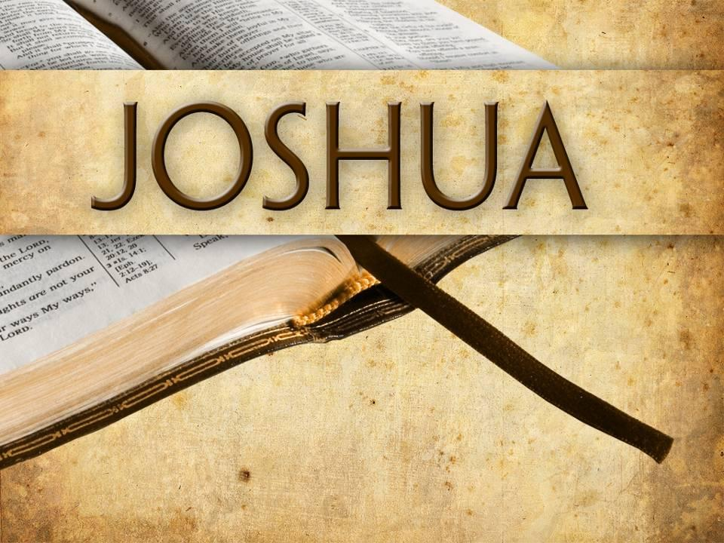
The False Prophets’ Lies
Jeremiah

Slide 2

True
or
False?

Slide 3
False!
Hananiah

Slide 4
“your brothers”
12:6

Slide 5
“smooth words”
12:6

Slide 6
Predicting peace
14:13; 23:17;
27:9

Slide 7
Accept speaking against
Jerusalem?

Slide 8
Everyone was accusing
everyone
of lying

Slide 9
“Who is the wise man who may understand this?”
9:12

Slide 10
Some similarities today

Slide 11
“But there were also false prophets among the people, even as there will be false teachers among you, who will secretly bring in destructive heresies, even denying the Lord who bought them, and bring on themselves swift destruction.”
2 Peter 2:1

Slide 12
“Beloved, do not believe every spirit, but test the spirits, whether they are of God; because many false prophets have gone out into the world...”
1 John 4:1-6

Slide 13
The False Prophets’ Lies
Jeremiah
Judean culture / climate hotbed
for false prophets

Slide 14
The False Prophets’ Lies
Jeremiah
Judean culture / climate hotbed
for false prophets
Need to be horrified by how
evil they were

Slide 15
The False Prophets’ Lies
Jeremiah
Judean culture / climate hotbed
for false prophets
Prophets conformed to their environment

Slide 16
The False Prophets’ Lies
Jeremiah
Judean culture / climate hotbed
for false prophets
People & Prophets
shared sin responsibility

Slide 17
The False Prophets’ Lies
Jeremiah
Identifying true and false prophets

Slide 18
The False Prophets’ Lies
Jeremiah
Identifying true and false prophets
Complete fulfillment of foretold events

Slide 19
The False Prophets’ Lies
Jeremiah
Identifying true and false prophets
Speaking by Jehovah God

Slide 20
The False Prophets’ Lies
Jeremiah
Identifying true and false prophets
Dedication to the Law and Covenant of Jehovah God

Slide 21
The False Prophets’ Lies
Jeremiah
Identifying true and false prophets
Dedication to message purity and personal obedience

Slide 22
The False Prophets’ Lies
Jeremiah
False prophet impact and what to do about it

Slide 23
The False Prophets’ Lies
Jeremiah
False prophet impact and what to do about it
Forgetting Jehovah God

Slide 24
The False Prophets’ Lies
Jeremiah
False prophet impact and what to do about it
Exchanging truth for a lie

Slide 25
The False Prophets’ Lies
Jeremiah
False prophet impact and what to do about it
Solution: Heart changes

Slide 26
The False Prophets’ Lies
Jeremiah
False prophet impact and what to do about it
Solution: Only the voice of God

Slide 27
The False Prophets’ Lies
Jeremiah
False prophet impact and what to do about it
Solution: Reject what is not from God

Slide 28
The False Prophets’ Lies
Jeremiah
False prophet impact and what to do about it
Solution: Keep preaching the TRUTH

Slide 29
The False Prophets’ Lies
Jeremiah
“…you will seek Me and find Me, when you search for Me with all your heart”
29:13

Slide 30
The False Prophets’ Lies
Jeremiah
God will “give them one heart”
32:39

Slide 31
The False Prophets’ Lies
Jeremiah
God’s law will be “in their minds” and written “on their hearts”
31:33

