Slide 1
Judah’s Sin & God’s Judgment
2017 SITS Conference

Slide 2
Jeremiah’s Lament
Jer. 8:18-22: ¹⁸I would comfort myself in sorrow; My heart is faint in me. ¹⁹Listen! The voice, The cry of the daughter of My people— From a far country: “Is not the Lord in Zion? Is not her King in her?” …. ²⁰“The harvest is past, The summer is ended, And we are not saved!” ²¹For the hurt of the daughter of my people I am hurt. I am mourning; Astonishment has taken hold of me. ²²Is there no balm in Gilead, Is there no physician there?....

Slide 3
Judah’s Sin

Slide 4
Judah’s sin
Persisted throughout her history
Pervaded society
Rejoiced to do evil
All kinds of iniquity

Slide 5
Judah’s Sins
Ignorance
Irreverence
Ingratitude
Infidelity
Idolatry
Immorality
Infanticide
Injustice
Impudence
Indifference
Impenitence

Slide 6

The Road To Ruin (Rom. 1:21-32)
Injustice
Immorality
Idolatry
Ignorance
Ingratitude
Irreverence

Slide 7
Brazon abandon
Treacherous Wife
Jer. 3:20-21
Young Camel & Wild Donkey
Jer. 2:23-24; 13:27
Lusty Stallion
Jer. 5:8
Arabian
Jer. 3:2

Slide 8
Absurd Foolishness
Snow Water for Strange Waters
Jer. 18:13-14
Highway for Pathway
Jer. 18:15

Slide 9
God’s judgment

Slide 10
God’s judgment
Because Of Judah’s Sins
Promised & Prophesied Throughout History

Slide 11
Repeated Warnings
Jer. 7:25-26: “²⁵Since the day that your fathers came out of the land of Egypt until this day, I have even sent to you all My servants the prophets, daily rising up early and sending them. ²⁶Yet they did not obey Me or incline their ear, but stiffened their neck. They did worse than their fathers”

Slide 12
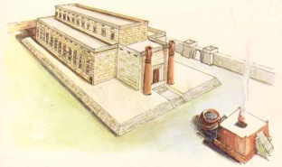
Repeated Warnings
I
J
1445 BC
1405 BC
1375 BC
947 BC
830-586 BC
Lev.
26
Dt.
27-28
Josh.
23:11-16
24:19-28
1 Ki.
8:46-53
9:6-7

Slide 13
Repeated Warnings
Joel (ca. 830? BC): 2:1-11
Amos (ca. 755 BC): 2:4-5
Isaiah (740-700 BC): 1:2-9, 19-20, 28-31; 2:10-22; 3:1-26; 4:1, 4; 5:1-30; 6:8-13; 22:1-14; 28:11-22; 29:1-4; 30:8-17; 32:9-14; 33:1, 7-16; 64:8-12
Micah (735-700 BC): 1:8-16; 3:8-12; 6:9-16

Slide 14
Repeated Warnings
Zephaniah (630-625 BC): 1:2-18; 3:6-7
Jeremiah (626-586 BC): 1:13-16; 2:14-19; 4:3-31; 5:1-6, 8-11, 14-19; 6:1-12, 15, 19, 21-26; 7:8-15, 20, 25-34; 8:1-3, 8-17; 9:10-22; 11:6-8, 11-12, 17; 13:1-14, 18-27; 14:1-6, 10-18; 15:1-9; 11-14; 16:1-9; 17:1-4; 18:1-11, 15-17; 19:1-13; 21:4-10; 22:1-9; 25:9-14; 26:1-6, 12-15, 17-18; 30:4-7; 31:15; 32:26-35; 33:1-5, 10-11; 34:1-7; 36:27-31; 37:6-1, 16-17; 38:1-3, 17-23

Slide 15
Repeated Warnings
Habakkuk (625-605 BC): 1:5-11
Ezekiel (593-570 BC): 4:1-17; 5:1-17; 6:1-14; 7:1-27; 8:1-18; 9:1-11; 10:1-22; 11:1-25; 12:1-20; 15:1-8; 16:35-43; 17:1-24; 20:45-49; 21:1-24; 23:46-49; 24:1-27

Slide 16
God’s judgment
Because Of Judah’s Sins
Promised & Prophesied Throughout History
Various Efforts To Avert It
Unleashed Sorrowfully & Regretfully
Curses Of The Covenant
Described in Minute & Ghastly Detail

Slide 17
Explicit Warnings
Dt. 28:53-57: ⁵³You shall eat the fruit of your own body, the flesh of your sons and your daughters whom the Lord your God has given you, in the siege and desperate straits in which your enemy shall distress you. ⁵⁴The sensitive and very refined man among you will be hostile toward his brother, toward the wife of his bosom, and toward the rest of his children whom he leaves behind, ⁵⁵so that he will not give any of them the flesh of his children whom he will eat, because

Slide 18
Explicit Warnings
he has nothing left in the siege and desperate straits in which your enemy shall distress you at all your gates. ⁵⁶The tender and delicate woman among you, who would not venture to set the sole of her foot on the ground because of her delicateness and sensitivity, will refuse to the husband of her bosom, and to her son and her daughter, ⁵⁷her placenta which comes out from between her feet and her children whom she

Slide 19
Explicit Warnings
bears; for she will eat them secretly for lack of everything in the siege and desperate straits in which your enemy shall distress you at all your gates.

Slide 20
Curses Of The Covenant
Curses | Lev. 26 | Deut. 28 | Fulfillment
Disease | 16, 25 | 21-22, 27, 35, 59-61 | Jer. 21:5-6
Defeat | 17 | 25 | Jer. 21:3-6
Drought | 19-20 | 23-24 | Jer. 14:1-6; 23:10
Wild Beasts | 22 |  | Jer. 7:33; 34:20
Dearth | 26 |  | Jer. 14:16; 32:24; 52:6
Cannibalism | 29 | 53-57 | Jer. 19:9; Lam. 2:20; 4:10
Destruction | 30 |  | Jer. 10:11
Desolation | 31-33 |  | Jer. 4:25-31; 44:1-3, 6

Slide 21
Curses Of The Covenant
Curses | Lev. 26 | Deut. 28 | Fulfillment
Deportation | 33 | 36, 41, 64, 68 | Jer. 16:13; 50:17
Distress | 36-37 | 28, 34, 65-67 | Jer. 10:18
Death | 38 | 62 | Jer. 9:21; 16:3-8
Deterioration | 39 |  | Ezek. 4:16-17
Oppression |  | 29, 33 | Jer. 50:33
Depredation |  | 29-33 | Jer. 4:20; 8:10; 20:5
Disgrace |  | 37, 43-44 | Jer. 3:24-25; 13:25-26
Invasion |  | 49-50 | Jer. 4:7; 5:15; 6:22-23
Siege |  | 52 | Jer. 21:4; 32:1-2; 39:1

Slide 22
Menacing Metaphors
Dry Desert Wind
Jer. 4:11-12
Woman In Labor
Jer. 4:31; 22:22-23
Gleaning Of Grapes
Jer. 6:9
Stumblingblocks
Jer. 13:12-22

Slide 23
Menacing Metaphors
Forest Fire
Jer. 21:13-14
Violent Whirlwind
Jer. 23:19-20; 30:23-24
Incurable Wound
Jer. 30:12-15
Ravenous Devouring
Jer. 5:6

Slide 24
Menacing Metaphors
Exposure Of Nakedness
Jer. 13:26; cf. Ezek. 16:37-38
Cosmic Cataclysm
Jer. 4:23-24

Slide 25
Composite picture
Judah’s land was invaded

Slide 26
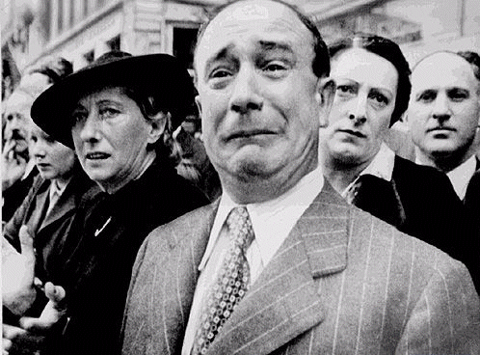
Parisians Mourn

Slide 27
Composite picture
Judah’s land was invaded
Judah’s people were terrified
Judah’s land was ravaged
Judah’s wealth was plundered
Judah’s defenses were destroyed
Judah’s capital city was besieged

Slide 28
Composite picture
Judah’s land was filled with death
Judah’s capital was conquered & destroyed
Judah’s temple was desolated & destroyed

Slide 29
God’s House Destroyed
2 Ki. 23:27: And the Lord said, “I will also remove Judah from My sight, as I have removed Israel, and will cast off this city Jerusalem which I have chosen, and the house of which I said, ‘My name shall be there.’”
Jer. 6:8: “Be instructed, O Jerusalem, Lest My soul depart from you; Lest I make you desolate, A land not inhabited”

Slide 30
God’s House Destroyed
Ezek. 24:21: “Behold, I will profane My sanctuary, your arrogant boast, the desire of your eyes, the delight of your soul….”

Slide 31
Composite picture
Judah’s land was filled with death
Judah’s capital was conquered & destroyed
Judah’s temple was desolated & destroyed
Judah’s people were deported

Slide 32
God’s judgment
Unimaginable Suffering & Sorrow

Slide 33
Great suffering
Lam. 1:1-5: ¹How lonely sits the city That was full of people! How like a widow is she, Who was great among the nations! …. ³Judah has gone into captivity, Under affliction and hard servitude…. ⁴The roads to Zion mourn Because no one comes to the set feasts. All her gates are desolate…. ⁵Her adversaries have become the master

Slide 34
Great suffering
Lam. 1:12: ¹²“Is it nothing to you, all you who pass by? Behold and see If there is any sorrow like my sorrow, Which has been brought on me, Which the Lord has inflicted In the day of His fierce anger

Slide 35
Great suffering
Lam. 2:6-7: ⁶He has done violence to His tabernacle, As if it were a garden; He has destroyed His place of assembly; The Lord has caused The appointed feasts and Sabbaths to be forgotten in Zion. In His burning indignation He has spurned the king and the priest. ⁷The Lord has spurned His altar, He has abandoned His sanctuary; He has given up the walls of her palaces Into the hand of the enemy

Slide 36
Great suffering
Lam. 2:11-13: ¹¹My eyes fail with tears, My heart is troubled; My bile is poured on the ground Because of the destruction of the daughter of my people, Because the children and the infants Faint in the streets of the city. ¹²They say to their mothers, “Where is grain and wine?” As they swoon like the wounded In the streets of the city, As their life is poured out In their mothers’ bosom. ¹³How shall I console you?

Slide 37
Great suffering
To what shall I liken you, O daughter of Jerusalem? What shall I compare with you, that I may comfort you, O virgin daughter of Zion? For your ruin is spread wide as the sea; Who can heal you?

Slide 38
Great suffering
Lam. 2:15-16: ¹⁵All who pass by clap their hands at you; They hiss and shake their heads At the daughter of Jerusalem: “Is this the city that is called ‘The perfection of beauty, The joy of the whole earth’?” ¹⁶All your enemies have opened their mouth against you; They hiss and gnash their teeth. They say, “We have swallowed her up! Surely this is the day we have waited for; We have found it, we have seen it!”

Slide 39
Great suffering
Lam. 2:20-21: ²⁰“See, O Lord, and consider! To whom have You done this? Should the women eat their offspring, The children they have cuddled? Should the priest and prophet be slain In the sanctuary of the Lord? ²¹“Young and old lie On the ground in the streets; My virgins and my young men Have fallen by the sword; You have slain them in the day of Your anger, You have slaughtered and not pitied.

Slide 40
Great suffering
Lam. 4:1: ¹How the gold has become dim! How changed the fine gold! The stones of the sanctuary are scattered At the head of every street.
Lam. 4:4-5: ⁴The tongue of the infant clings To the roof of its mouth for thirst; The young children ask for bread, But no one breaks it for them. ⁵Those who ate delicacies Are desolate in the streets; Those who were brought up in scarlet Embrace ash heaps.

Slide 41
Great suffering
Lam. 4:9-10: ⁹Those slain by the sword are better off Than those who die of hunger; For these pine away, Stricken for lack of the fruits of the field. ¹⁰The hands of the compassionate women Have cooked their own children; They became food for them In the destruction of the daughter of my people.

Slide 42
Great suffering
Lam. 5:8-15: ⁸Servants rule over us; There is none to deliver us from their hand. ⁹We get our bread at the risk of our lives, Because of the sword in the wilderness. ¹⁰Our skin is hot as an oven, Because of the fever of famine. ¹¹They ravished the women in Zion, The maidens in the cities of Judah. ¹²Princes were hung up by their hands, And elders were not respected.

Slide 43
Great suffering
¹³Young men ground at the millstones; Boys staggered under loads of wood. ¹⁴The elders have ceased gathering at the gate, And the young men from their music. ¹⁵The joy of our heart has ceased; Our dance has turned into mourning

Slide 44
God’s judgment
Unimaginable Suffering & Sorrow
Came To Pass As Prophesied
Tempered With Mercy
Prophesies Intermingled With Promises Of Blessing

Slide 45
God’s judgment
Unimaginable Suffering & Sorrow
Came To Pass As Prophesied
Tempered With Mercy
Prophesies Intermingled With Promises Of Blessing

Slide 46
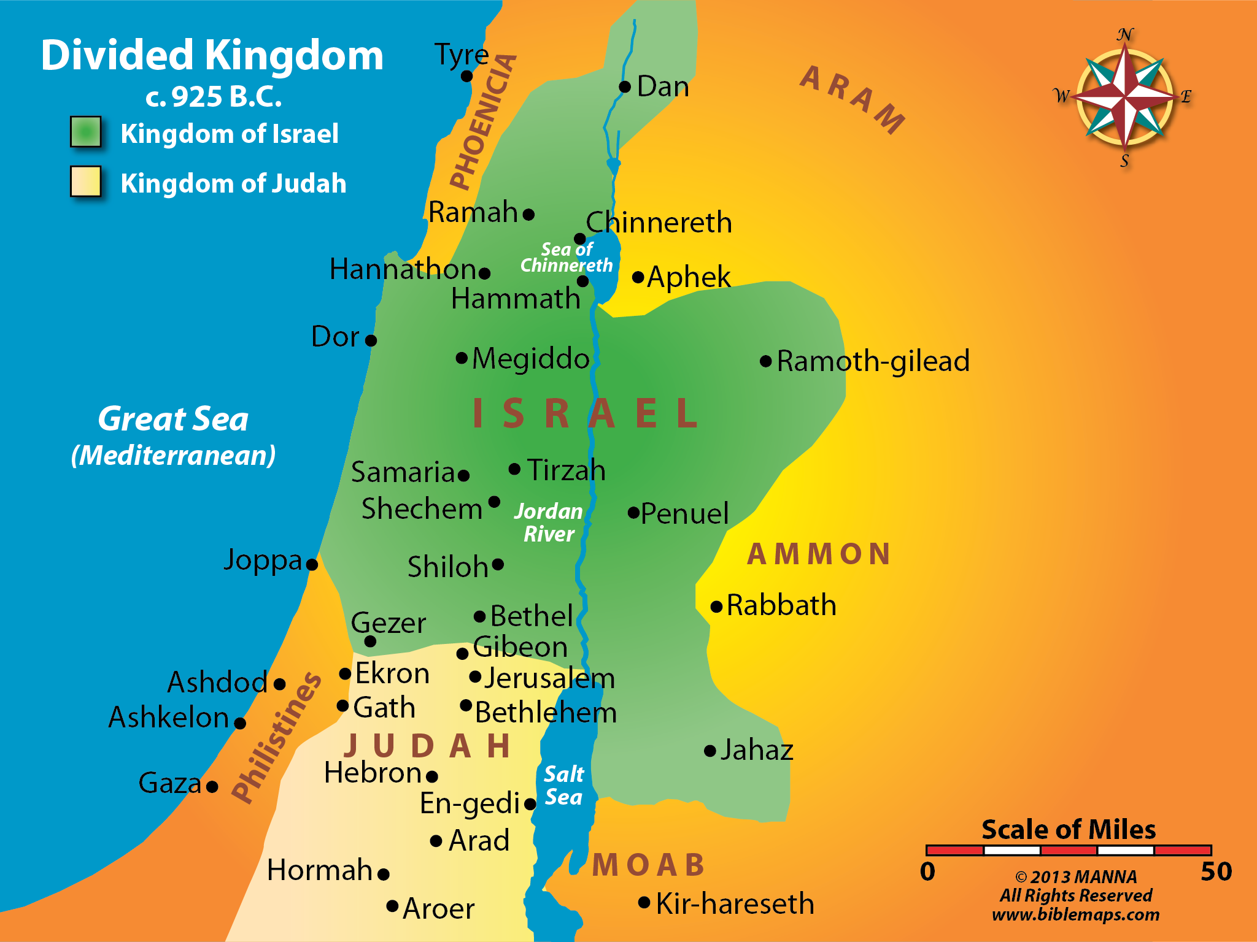
F
U
L
F
I
L
L
M
E
N
T
605
597
586

Slide 47
Destruction Of Jerusalem
2 Ki. 25:9-11: ⁹He burned the house of the Lord and the king’s house; all the houses of Jerusalem, that is, all the houses of the great, he burned with fire. ¹⁰And all the army of the Chaldeans who were with the captain of the guard broke down the walls of Jerusalem all around. ¹¹Then Nebuzaradan the captain of the guard carried away captive the rest of the people who remained in the city and the defectors who had deserted to the king of Babylon, with the rest of the multitude (cf. 2 Chr. 36:19-21)

Slide 48
Promises of blessing
Nations Punished
Remnant Restored To The Land
Nations Plucked Out & Later Returned
Remnant Ruled By Branch Of Righteousness
New Covenant

Slide 49
Judgment On Nations (Jer. 46 – 51)
Egypt (46:1-28) | Damascus (49:23-27)
Philistia (47:1-7) | Kedar & Hazor (49:28-33)
Moab (48:1-47) | Elam (49:34-39)
Ammon (49:1-6) | Babylon (50:1-46; 51:1-58)
Edom (49:7-22)

Slide 50
Lessons for us

Slide 51
God’s Judgment Fell
God’s people did not heed God’s warnings

Slide 52
Get rid of messenger
They threatened his life (Jer. 11:21-23)
They slandered him (Jer. 18:18)
The struck him and put him in stocks (Jer. 20:1-3)
They threw him in prison (Jer. 32:1-2; 37:15-21)
They threw him in a miry dungeon (Jer. 38:6-13)
It Didn’t Change The Truthfulness Of His Message

Slide 53
Ignore the message
Ezek. 33:30-33: ³⁰ “As for you, son of man, the children of your people are talking about you beside the walls and in the doors of the houses; and they speak to one another, everyone saying to his brother, ‘Please come and hear what the word is that comes from the Lord.’ ³¹ So they come to you as people do, they sit before you as My people, and they hear your words, but they do not do them; for with their mouth they show much love, but their hearts pursue their own gain. ³² Indeed

Slide 54
Ignore the message
you are to them as a very lovely song of one who has a pleasant voice and can play well on an instrument; for they hear your words, but they do not do them. ³³ And when this comes to pass—surely it will come—then they will know that a prophet has been among them.”

Slide 55

Smooth preaching
Outright Error
Vague Generalities
Irrelevant

Slide 56
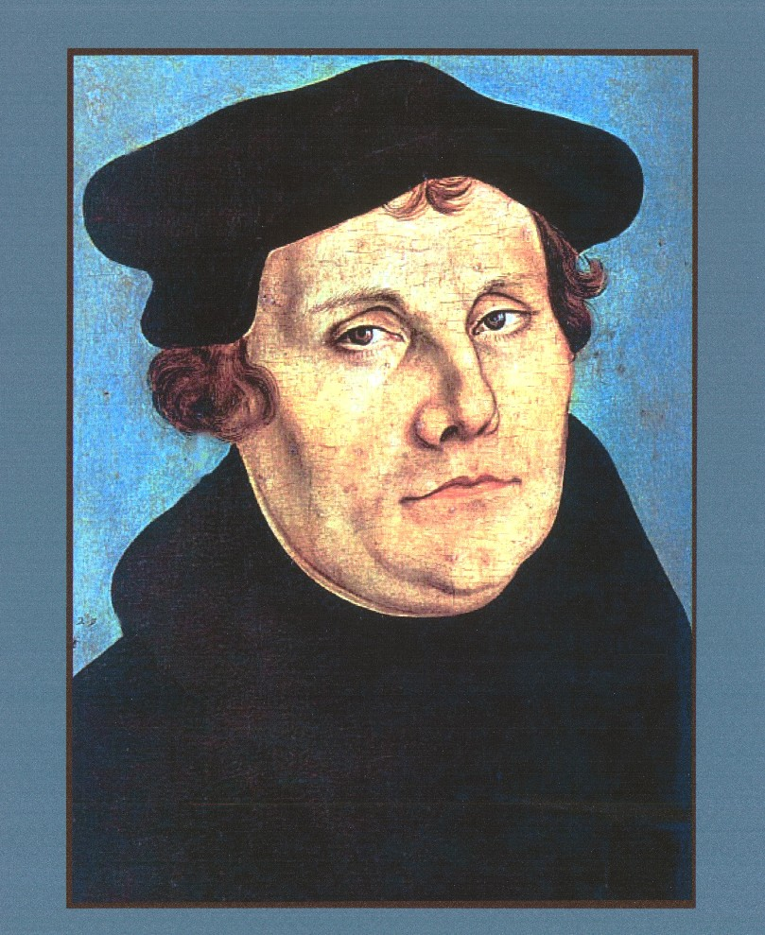
Martin Luther
“If I profess with the loudest voice and clearest exposition every portion of the truth of God except precisely that little point which the world and the devil are at that moment attacking, I am not confessing Christ, however boldly I may be professing Christ. Where the battle rages, there the loyalty of the soldier is proved, and to be steady on all the battlefield besides, is mere flight and disgrace if he flinches at that point.” (MacArthur, Expository Preaching, 98)

Slide 57
God’s Judgment Fell
God’s people did not heed God’s warnings
God’s people refused to repent
God’s people viewed the temple as a talisman
God’s people were cut off from the benefits and blessings of God’s presence
God’s people suffered the horrible consequences of God’s absence

Slide 58
Everything God Is Not
God
Hell
Light
Hope
Eternal Life
Righteous & Holy
Truth
Love
No Tears
Outer Darkness
Torment Forever
Eternal Death
Cesspool Of Putridity
Father Of Lies & Liars
Hate
Weeping & Gnashing Of Teeth

