Slide 1
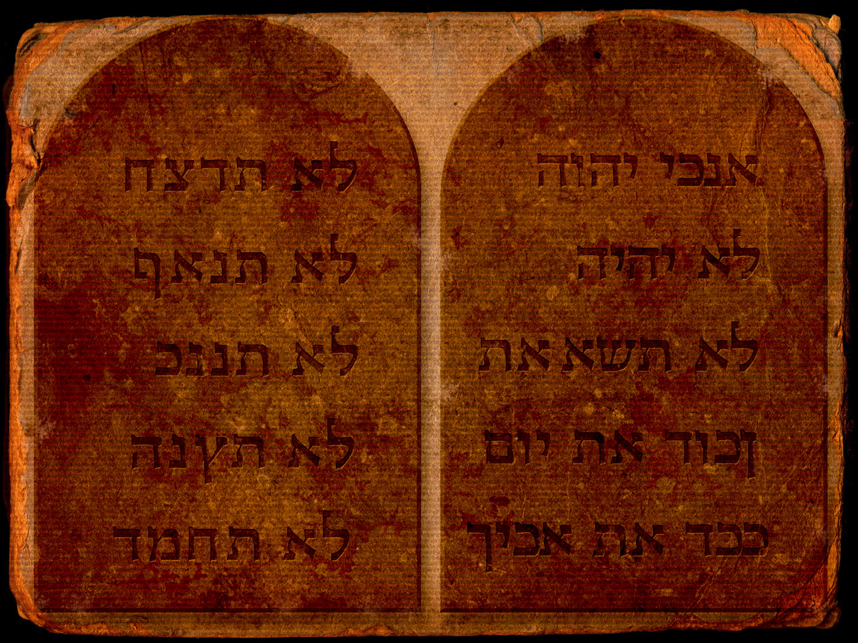
Early
Christians
AND THE LAW OF MOSES

Slide 2

Early Christians
AND THE LAW OF MOSES
“Faith in Christ and knowledge of the gospel is the exegesis and fulfilling of the law.” – Clement of Alexandria, Miscellanies 4.21.130.
p. 46

Slide 3
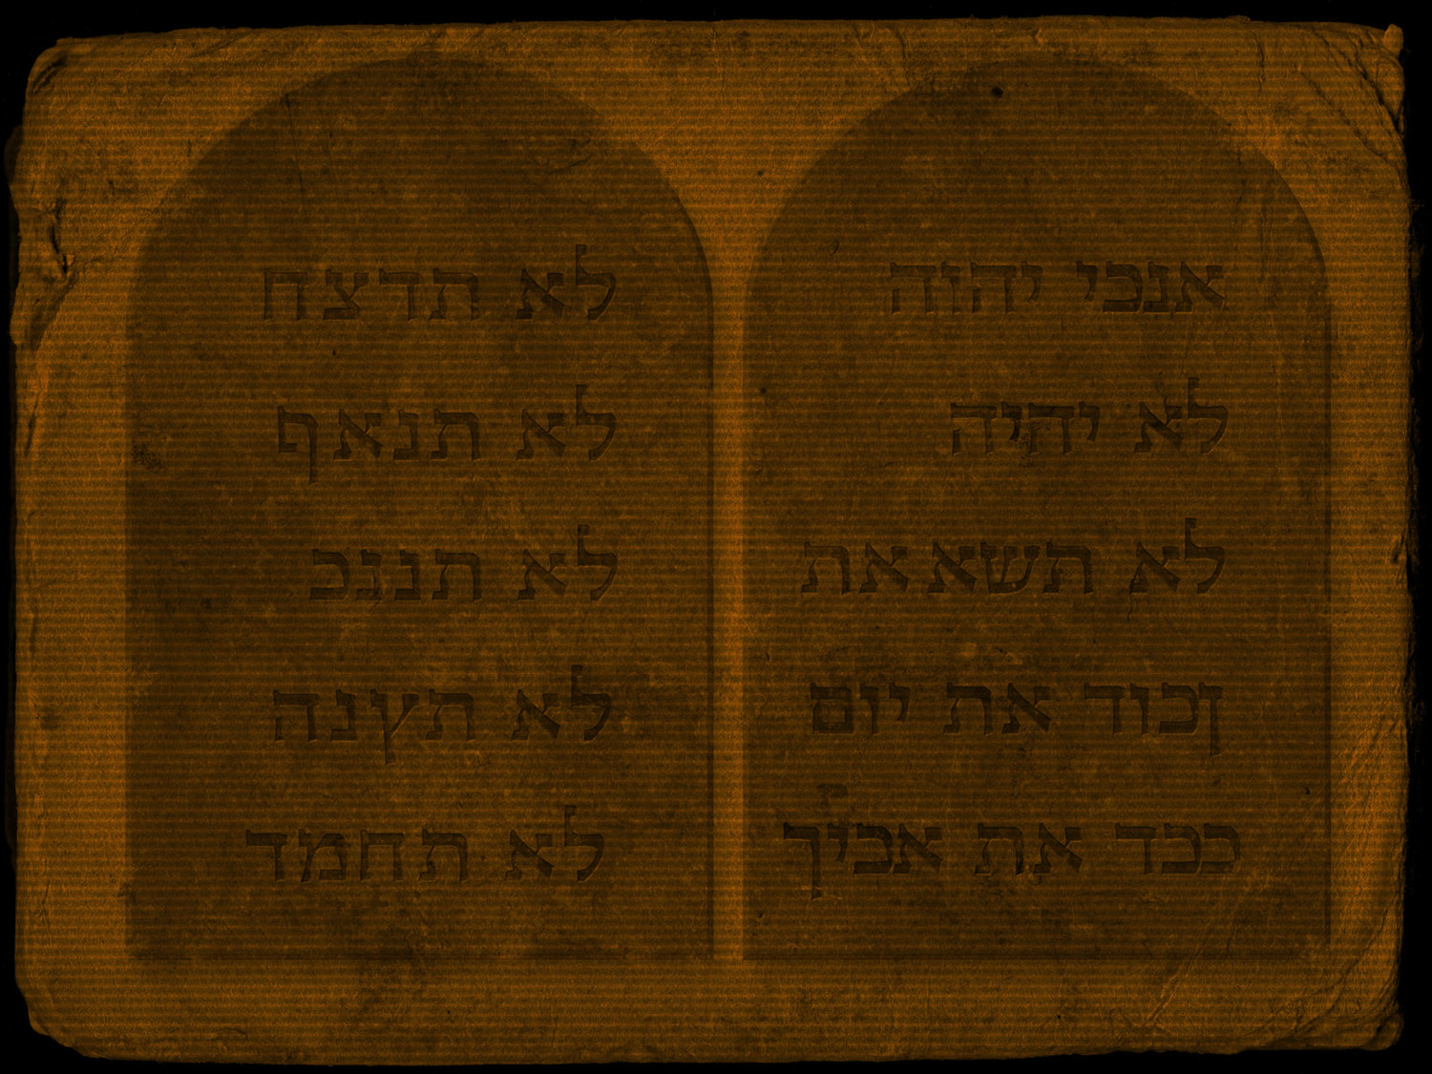


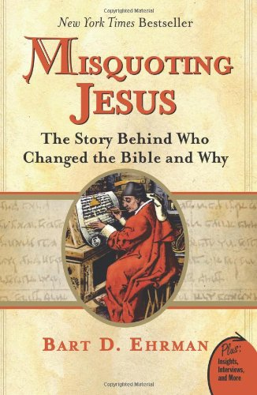

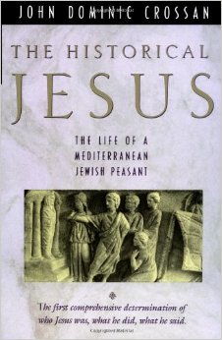
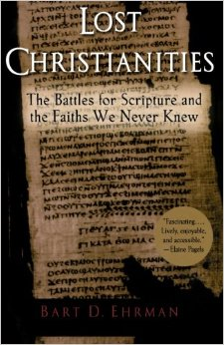
“Thanks, BAUR & BAUER”
p. 47

Slide 4
Ebionites
Marcionites
Reject 3 of the 4 gospel witnesses. Only Matthew.
Reject the apostle Paul, calling him an apostate.
Reject the virgin birth or that Jesus Christ is “Son of God.”
Demand Torah observance as part of the gospel of Jesus Christ.
Practiced some NT rites, like Sunday assembly
Reject the OT from Bible and NT limited to Luke and Pauline letters.
The Law of Moses against the Gospel
God of the OT is not the God of the NT. Many gods
Christ came to destroy the Law, not fulfill it.
Marcion blazes a trail for various Gnostics over the next 2 centuries
p. 79-81

Slide 5
Early Christians
AND THE LAW OF MOSES
The Apostles’ Consistent Interpretation & Application of the Law of Moses in their Mission
p. 47

Slide 6
The World Had Already Seen…
Hellenizing
NOT THESE
The Apostles’ Mission:
EVANGELIZING
THIS
p. 47

Slide 7
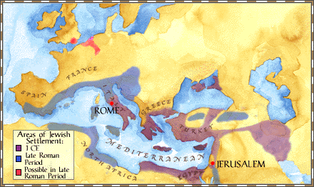
Hellenizing & Jewish Diaspora
Western Diaspora:
Spoke Greek & used LXX
Palestine & Eastern Diaspora: Spoke Aramaic & used Targum
p. 47

Slide 8
The World Had Already Seen…
Hellenizing
Judaizing
NOT THESE
The Apostles’ Mission:
EVANGELIZING
THIS
p. 48

Slide 9
Acts 15: The Apostles Were Not Judaizing
The Apostles taught Jews and Gentiles alike how to be saved in Jesus Christ
The apostles called Gentiles to “turn to God” by Faith in Jesus Christ not by Torah observance (Acts 15:14, 19; 26:17-20)
God does not “Bait and Switch.”
  Gentile Christians are not going to be getting circumcised and not going to be keeping the Law of Moses.
  The epistle (Acts 15:23-29)
p. 48-49

Slide 10
Acts 15: The Apostles Were Not Judaizing
The Apostles taught Jews and Gentiles alike how to be saved in Jesus Christ
The apostles called Gentiles to “turn to God” by Faith in Jesus Christ not by Torah observance (Acts 15:14, 19; 26:17-20)
God does not “Bait and Switch.”
The Apostles’ failure to preach Torah observance was controversial-- but also a determined choice.
p. 50

Slide 11
Early Christians
AND THE LAW OF MOSES
“But we believe that through the grace of the Lord Jesus Christ we shall be saved in the same manner as they.” – Peter, Acts 15:11.
p. 50

Slide 12
The World Had Already Seen…
Hellenizing
Judaizing
Proselytizing
NOT THESE
The Apostles’ Mission:
EVANGELIZING
THIS
p. 50

Slide 13
Christian Self-Identification in Acts
The Way (Acts 9:2; 18:25-26; 19:9, 23; 24:14, 22; 22:4).
The Holy Ones – Saints (Acts 9:13, 32, 41; 26:10).
The Disciples (Acts 6:1-2, 7; 9:1, 25; 15:10).
The Brethren (Acts 6:3; 10:23; 11:12).
The Church (Acts 8:3; 9:31; 14:23).
Christians (Acts 11:26; 26:28-29).
p. 52

Slide 14
The World Had Already Seen…
Hellenizing
Judaizing
Proselytizing
NOT THESE
The Apostles’ Mission:
EVANGELIZING
THIS
p. 52

Slide 15
Evangelism: A New “Way”
Imitate Jesus Christ – this is Christianizing
Jew & Gentile can choose to be citizens of the Kingdom of God
“Christians are made, not born” - Tertullian
p. 52

Slide 16
Apostles & OT Scriptures
They had a high view of Scripture
  God Breathed
  True
  Unbreakable
  “Law” can be accommodative term encompassing other genre of OT
The Law of Moses is the ally corroborating their controversial testimony: Jesus of Nazareth is the Messiah
Jesus Christ is the fulfillment and explanation of the Law of Moses
p. 53

Slide 17
Expositing the OT:
Jesus Christ
Old Testament
New Testament
Types
Allegory
Shadows
Mystery
Veiled
Prophecies
Antitypes
Reality
Substance
Manifestation
Unveiled
Fulfillment
Continuity from OT to the NT
p. 54

Slide 18
John-LAW PARALLEL
John to Jesus
O.T. to N.T.
From God
In Wilderness
Identify the Christ: Spirit as dove
Precursor points to Successor
Led people to Jesus
From God
Sinai Wilderness
Identify Christ: Prophecies & Promises
Moses to a Prophet; OT precursor to NT
Leads people to Jesus
p. 55-56

Slide 19
John-LAW PARALLEL
John to Jesus
O.T. to N.T.
One comes after is Ranked Higher
Joy Fulfilled in Jesus
“He must Increase but I must Decrease”
“Follow the Son”
Message & Baptism YIELDS to Christ’s Salvation
OT came first, NT is greater
OT Fulfilled by Jesus
“Growing old is ready to vanish away”
Jesus is Lord – Follow the Christ
OT system yielded to NT Way of Salvation
p. 56-57

Slide 20
Early Christians
AND THE LAW OF MOSES
Paul: Being Israelite and Keeping the Faith
p. 61

Slide 21
Galatians 2:16, 21
…knowing that a man is not justified by the works of the law but by faith in Jesus Christ, even we have believed in Christ Jesus, that we might be justified by faith in Christ and not by the works of the law; for by the works of the law no flesh shall be justified…. I do not set aside the grace of God; for if righteousness comes through the law, then Christ died in vain.
p. 61-65

Slide 22
1 Corinthians 9:19-23
For though I am free from all men, I have made myself a servant to all, that I might win the more; 20 and to the Jews I became as a Jew, that I might win Jews; to those who are under the law, as under the law, that I might win those who are under the law; 21 to those who are without law, as without law (not being without law toward God, but under law toward Christ), that I might win those who are without law; 22 to the weak I became as weak, that I might win the weak. I have become all things to all men, that I might by all means save some. 23 Now this I do for the gospel’s sake, that I may be partaker of it with you.
p. 66

Slide 23
1 Corinthians 10:32-11:1
Give no offense, either to the Jews or to the Greeks or to the church of God, 33 just as I also please all men in all things, not seeking my own profit, but the profit of many, that they may be saved. Imitate me, just as I also imitate Christ.
p. 66

Slide 24
Paul Behaves Exactly As We’d Expect
Going to Synagogues First to Preach
Circumcising Timothy (Acts 16:1-3)
Taking a Vow (Acts 18:18)
Traveling for religious festivals (Acts 18:21-22; 20:16)
Observing the Sabbath (Acts 13:14, 44; 16:13)
Agrees to James’ plan to sponsor vows (Acts 21:17-30)
p. 66-69

Slide 25
Early Christians
AND THE LAW OF MOSES
The Law of Moses for Every Christian
p. 81

Slide 26
The Law of Moses for Today
Points to Christ
Shows the unfolding of God’s Plan
Instructs in Salvation
Righteous Examples
Warning Disobedient
Gives Hope
Reveals God’s Nature
Informs Christian World View
Shows Pattern of God’s Revelation
p. 81-83

Slide 27
Early Christians
AND THE LAW OF MOSES
“Faith in Christ and knowledge of the gospel is the exegesis and fulfilling of the law.” – Clement of Alexandria, Miscellanies 4.21.130.
p. 46, 83

Slide 28
Early
Christians
AND THE LAW OF MOSES

